Slide 1
Rail-fence cipher
Supervised by
Dr Karim Abo Samra & Eng Nagham Ayman
Prepared by
Engy Elghetany
Perihan Hassan
Yahia Mostafa
Omar Dawaba
Saif Bakry

Slide 2
Outline
Introduction
Algorithm explanation
System implementation
Screenshots From our System

Slide 3
Introduction
Rail-fence is one of the transposition techniques that mixes up the request for the letters of a message utilizing an essential calculation. The rail fence figure works by composing your message on exchange lines over the page, and afterward perusing off each line thus.
We made a GUI that will take the given plain-text message and a numeric key, encrypt/decrypt the given text using Rail Fence algorithm.

Slide 4
Algorithm
Encryption:
The plain text is written down on a sequence of columns according to the depth (no. of rows)
Cipher text is read off as a sequence of rows.
Decryption:
The plain text is written down on a sequence of rows
Then read off as a sequence of columns

Slide 5
Algorithm
The Rail fence Cipher is easy to use to jumble up a message very quickly. It has some problems depending on what route you pick as you can end up with large chunks of plaintext in the right order within the ciphertext (or simply reversed) which gives away alot about the width of the grid and the route used.
An historical use of the rail fence Cipher was the Union rail fence Cipher used by the Union forces during the American Civil War. Rather than transposing letters by the given route, it moved whole words around.

Slide 6
Implementation
import javafx.application.Application;
import javafx.event.ActionEvent;
import javafx.event.EventHandler;
import javafx.geometry.Pos;
import javafx.scene.Scene;
import javafx.scene.control.Button;
import javafx.scene.control.Label;
import javafx.scene.control.TextField;
import javafx.scene.layout.GridPane;
import javafx.scene.layout.HBox;
import javafx.scene.layout.StackPane;
import javafx.scene.layout.VBox;
import javafx.stage.Stage;
/**
*
* @author Dawaba
*/
public class Secuirty_project extends Application {
@Override

Slide 7
Implementation
public void start(Stage primaryStage) {
Button btn_enc = new Button();
Button btn_dec = new Button();
Label key_text = new Label("Enter Key");
TextField key_field = new TextField();
TextField enc_field = new TextField();
enc_field.setMaxWidth(250);
TextField dec_field = new TextField();
dec_field.setMaxWidth(250);

Slide 8
Implementation
btn_enc.setText("encrypt");
btn_enc.setOnAction(new EventHandler<ActionEvent>() {
@Override
public void handle(ActionEvent event) {
String key = key_field.getText();
int numRails = Integer.parseInt(key);
String data = enc_field.getText();
char[] encrypted = new char[data.length()];
int n = 0;
rail_fence rf = new rail_fence();
rf.input = data;
rf.key=numRails;
String enrypted_word = rf.encryption();

Slide 9
Implementation
dec_field.setText(enrypted_word);
}
});
btn_dec.setText("decrypt");
btn_dec.setOnAction(new EventHandler<ActionEvent>() {
@Override
public void handle(ActionEvent event) {
String key = key_field.getText();
int numRails = Integer.parseInt(key);
String data = dec_field.getText();
char[] encrypted = new char[data.length()];
int n = 0;

Slide 10
Implementation
rail_fence rf = new rail_fence();
rf.input = data;
rf.key=numRails;
String enrypted_word = rf.decryption();
enc_field.setText(enrypted_word);
}
});
VBox hroot = new VBox();
hroot.setAlignment(Pos.CENTER);
hroot.setSpacing(20);
GridPane root = new GridPane();

Slide 11
Implementation
root.setAlignment(Pos.CENTER);
root.setHgap(20);
root.add(key_text, 0, 0);
root.add(key_field, 1, 0);
hroot.getChildren().add(root);
hroot.getChildren().add(enc_field);
hroot.getChildren().add(btn_enc);
hroot.getChildren().add(dec_field);
hroot.getChildren().add(btn_dec);
Scene scene = new Scene(hroot, 300, 250);
primaryStage.setTitle("Secuirty Project");
primaryStage.setScene(scene);
primaryStage.show();
}
/**
* @param args the command line arguments
*/
public static void main(String[] args) {
launch(args);
}
}

Slide 12
Implementation
public class rail_fence {
int key;
String input;
public String encryption()
{
char[] input_array = input.toCharArray();
char[] output = new char[input.length()];
int i = 0 , j = 0;
int length = input.length();
int x = input.length()% 2;
if(x==1)
{
while(j < input.length()){
output[j] = input_array[i];
j++;
i = (i+key)%input.length();
}
}
else {
while(j < input.length()){
output[j] = input_array[i];
j++;
if(i == key){
i = (i+key)%(input.length());
i++;
}
else if(i < key)
{
i = (i+key)%(input.length());
}

Slide 13
Implementation
else {
i=1+i;
i = (i+key)%(input.length());
}
}
}
return new String(output) ;
}
public String decryption()
{
int length = input.length();
int ylength=(int) Math.ceil((double)length/key);
char[] input_array = input.toCharArray();
char[] output = new char[input.length()];
int i = 0 , j = 0;
int x = input.length()% 2;
if(x==1){
while(j < input.length()){
output[j] = input_array[i];
j++;
i = (i+ylength)%input.length();
}
}
else {
while(j < input.length()){
output[j] = input_array[i];
j++;

Slide 14
Implementation
if(i == key){
i = (i+ylength)%(input.length());
}
else if(i < key)
{
i = (i+ylength)%(input.length());
}
else
{
i=i+1;
i = (i+ylength)%(input.length());
}
}
}
return new String(output); } }

Slide 15
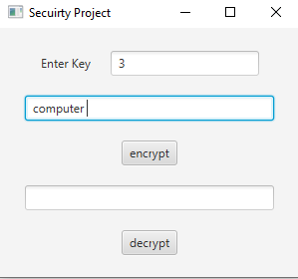
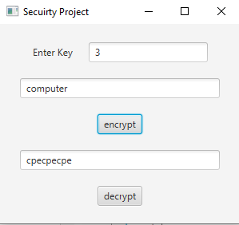
Screenshots
Before encryption
After encryption

Slide 16
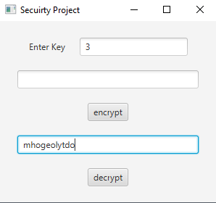
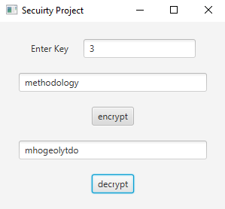
Screenshots
Before decryption
After decryption

Slide 17
Any question

Slide 18
Thank you

